Slide 1
Czechoslovakia Banking Data Analysis Project
By:- Swati Khedekar

Slide 2
Czechoslovakia Banking Data Analysis Project
Project Overview:
This project entails a comprehensive analysis of financial data from Czechoslovakia Bank over a five-year period. The dataset includes crucial information about the bank’s clients, accounts, cards, loans, transactions, and orders. The objective of this analysis is to provide the Czechoslovakia Bank with actionable insights that can help them make informed decisions about their financial operations. The analysis will involve data cleaning, exploratory data analysis, and predictive modelling to identify patterns and trends in the data.

Slide 3
Dataset Description:
The dataset consists of following eight tables:
Account – Information about bank accounts.
Card – Details of issued credit and debit cards.
Disposition – Relationships between clients and accounts.
District – Demographic data of different regions.
Loan – Information on loans issued by the bank.
Order – Records of financial orders.
Transaction – Historical transactions of bank accounts.

Slide 4
Project Workflow:
Step 1: Data Preprocessing in MS Excel
Step 2: Data Storage in AWS S3
Step 3: Data Processing in Snowflake
Step 4: Data Visualization in Power BI

Slide 5
Project Workflow:
This end-to-end financial data analytics model is fully automated and follows four key steps:
Step 1: Data Preprocessing in MS Excel
Basic data cleaning.
Converting file types to CSV for further processing.
Step 2: Data Storage in AWS S3
Creating an S3 bucket for data storage.
Assigning appropriate IAM roles and policies for secure access.

Slide 6
Project Workflow:
Step 3: Data Processing in Snowflake
Setting up a Warehouse, Database, Schema, and Tables.
Performing advanced data cleaning in Snowflake.
Creating storage integration between Snowflake and AWS S3.
Defining file formats and staging the data.
Establishing an automated data Snowpipe between AWS S3 and Snowflake.
Implementing notification alerts for data updates.
Step 4: Data Visualization in Power BI
Establishing a connection between Power BI and Snowflake to extract data & data modelling.
Writing DAX queries for data transformation.
Developing interactive dashboards and key performance indicators (KPIs).
Generating business insights based on the analyzed data.

Slide 7
Ad-hoc Data Analysis:
The project also involves answering key business questions, such as:
Analyzing the demographic distribution of clients across different districts.
Identifying the most common types of accounts and cards used by clients.
Assessing the bank’s loan portfolio and expense patterns.
Exploring strategies to enhance customer service and satisfaction levels.

Slide 8
This analysis includes:
Data cleaning to ensure data quality.
Exploratory data analysis (EDA) to uncover trends and patterns.
Predictive modeling to derive business insights.

Slide 9
Data Model & Tools
Tools Used:
Power BI
SQL (Snowflake)
AWS Cloud s3
MS Excel

Slide 10
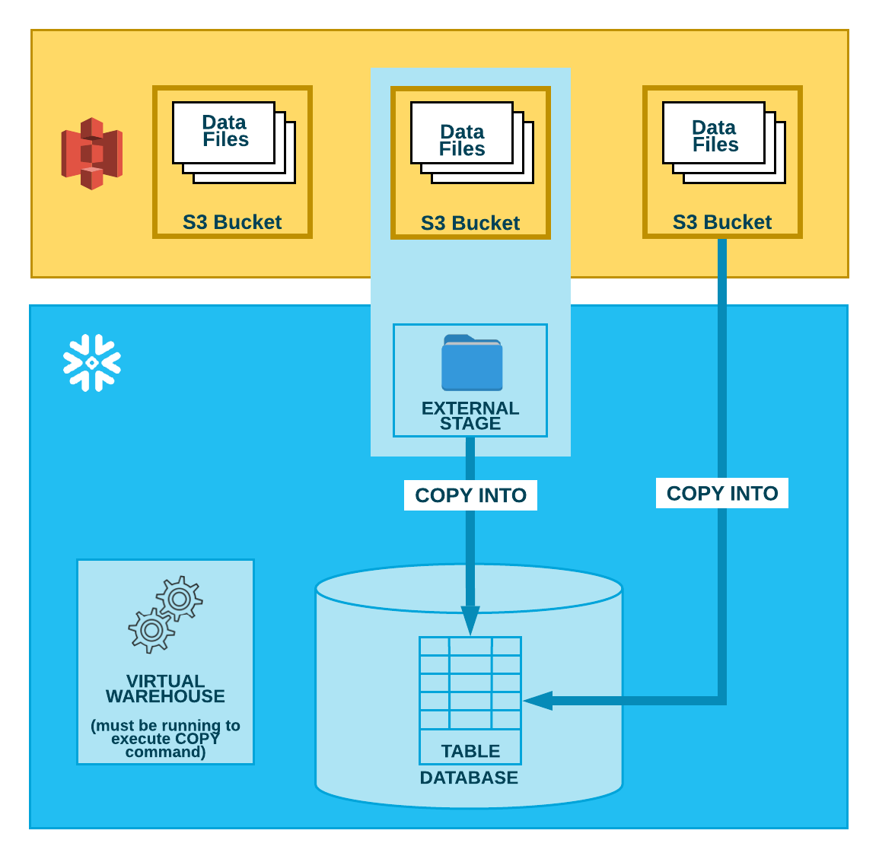



Data Loading Pipeline
Fig 1: Data loading pipeline

Slide 11
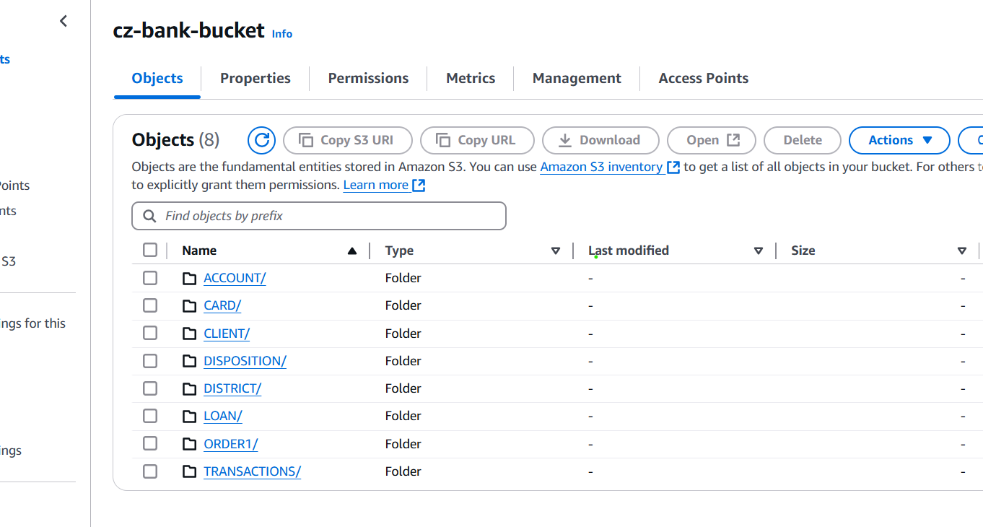
Fig 2 : AWS s3 bucket with all dataset

Slide 12
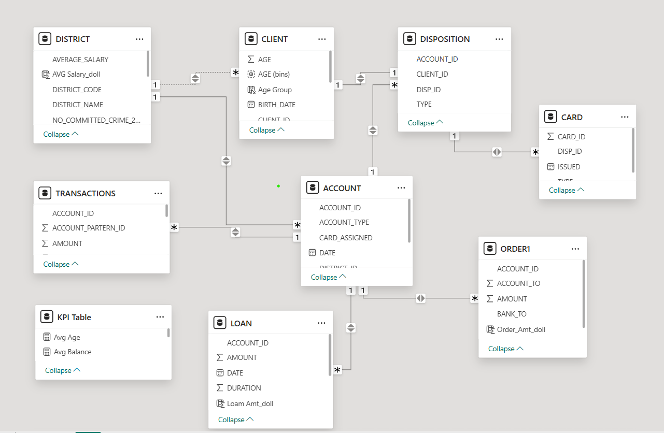
Fig 3: Data model in Power bi

Slide 13
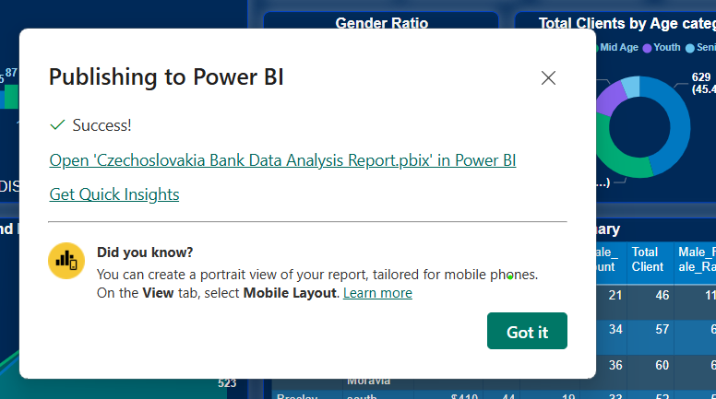
Fig 4: Publish report on Power bi service

Slide 14
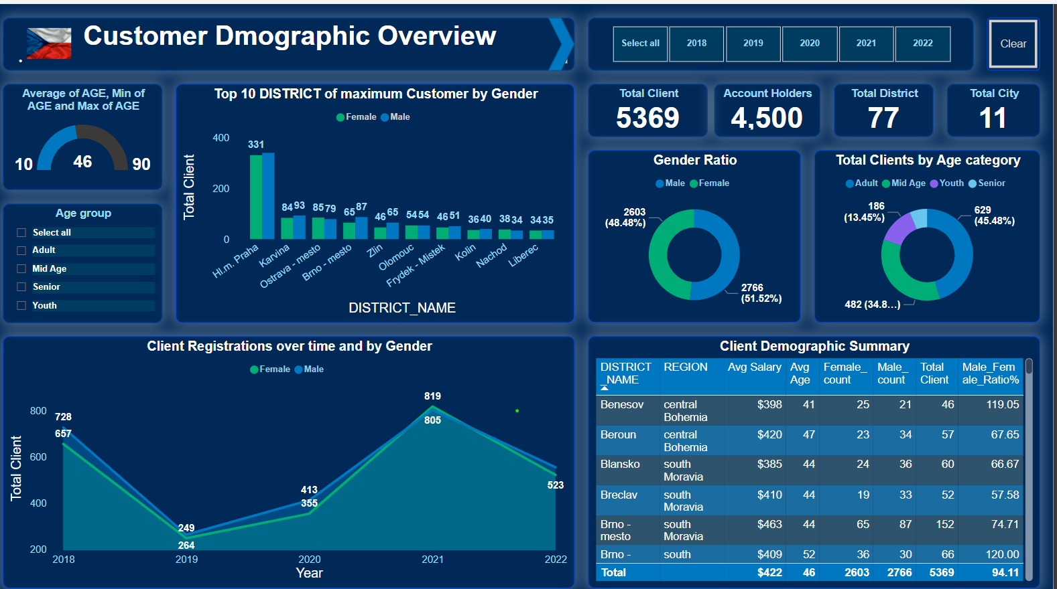

Slide 15

Live Interactive Power bi report
Power bi Dashboard link

Slide 16
Project Benefits
By working on a real-world dataset, participants will gain hands-on experience in:
Data cleaning and preprocessing
Cloud data storage and pipeline automation
Data visualization and reporting
Exploratory data analysis and predictive modeling
The insights generated from this project can help Czechoslovakia Bank enhance financial operations, optimize customer engagement, and introduce new financial products or services.

Slide 17
Thank You!!

